Slide 1
How to work with the Sustainable Development Goals in school education

Slide 2
Examples of what we have done at Klara Teoretiska Gymnasium in Sundsvall
Presentations in English class
Collaboration with charities
Lunch app
Student initiatives: trading clothes, raising money …

Slide 3
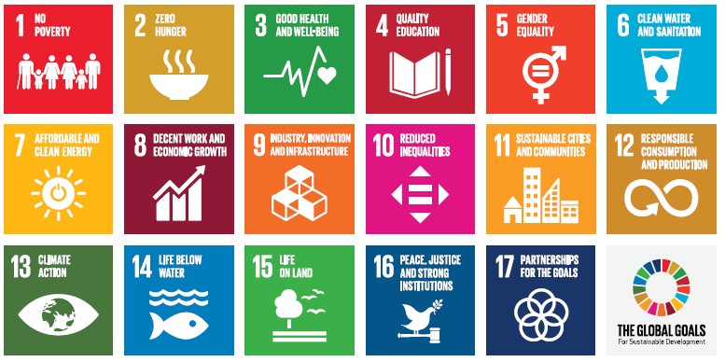
Presentations in English
First thing, first year (grade one).
In pairs: reading about and present one of the Global Goals to your classmates.
Works like an introduction to the Agenda 2030.

Slide 4
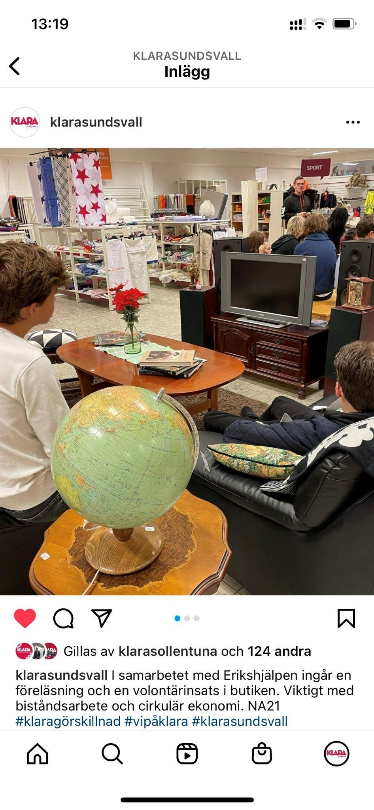

Collaboration with Erikshjälpen
Lecture from the store manager about second hand and circular economy.
Volunteering at the store: sorting and displaying.

Slide 5
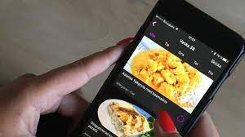

Lunch mobile app
School lunches are mostly free in Sweden
Students order their food in advance with the app
Makes it possible to choose from more dishes
Less food goes to waste

Slide 6
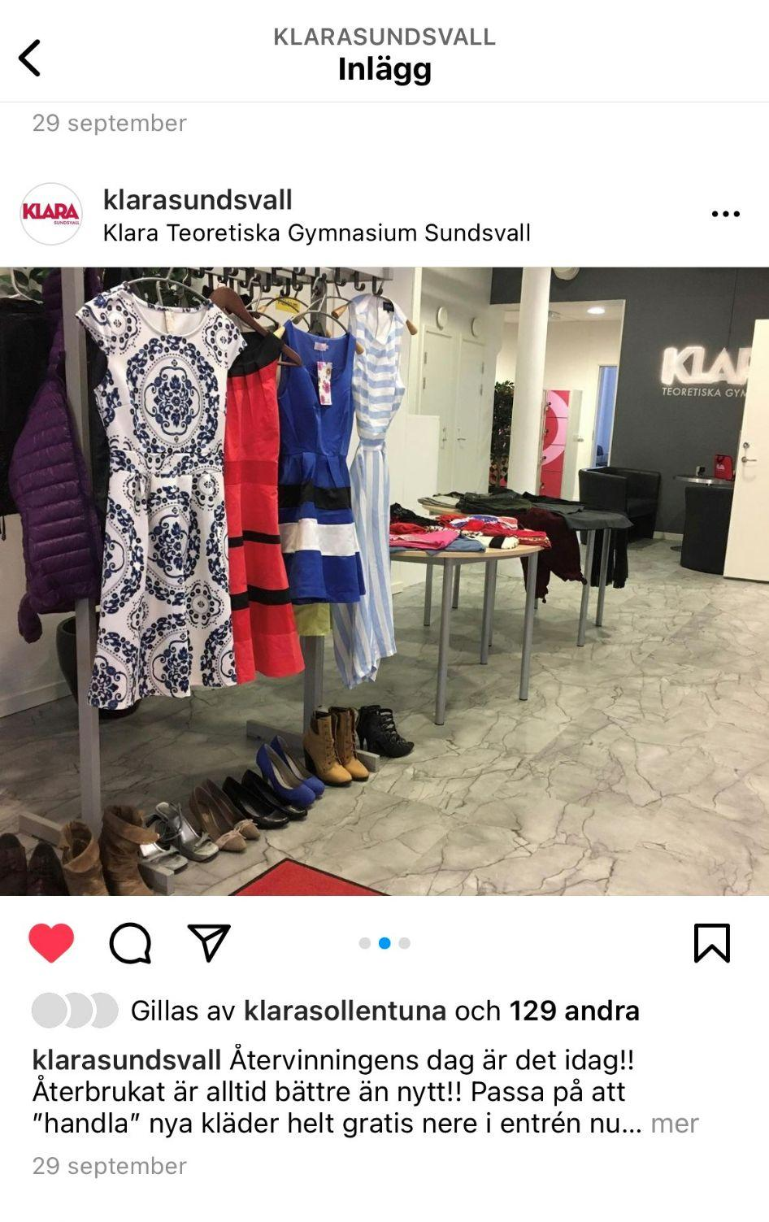
Trading clothes
Students (and teachers) can bring old clothes to school
You leave clothes that you don’t use anymore and take clothes that you like
Clothes that nobody wants are donated to charity

Slide 7
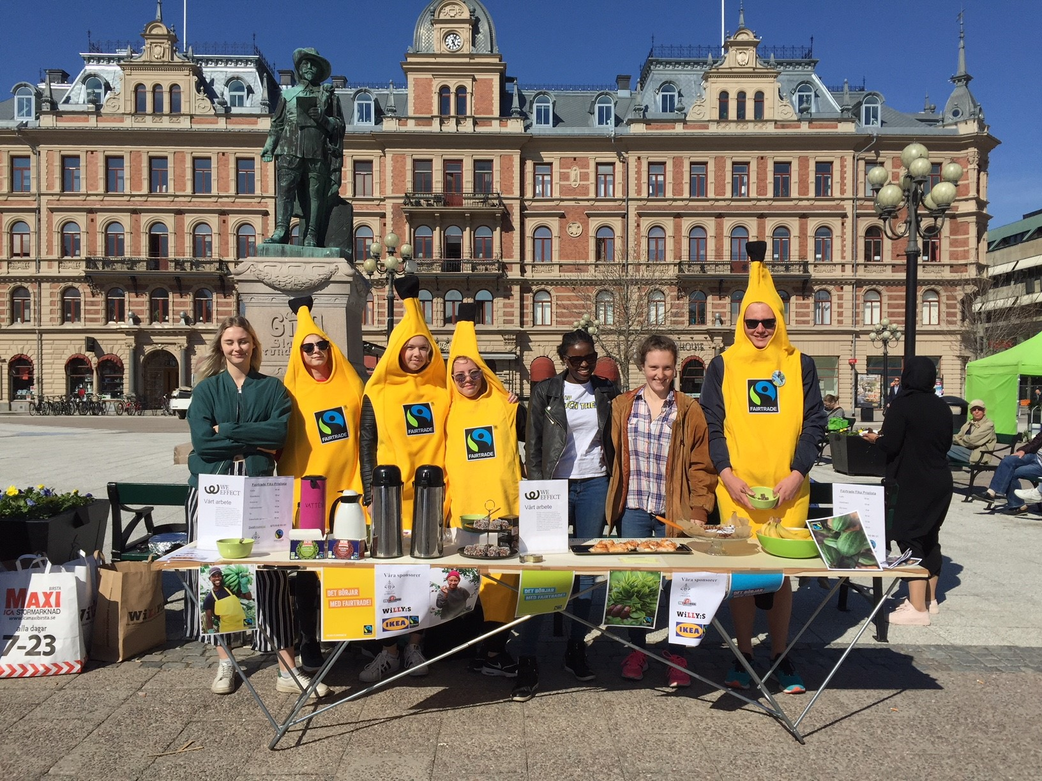
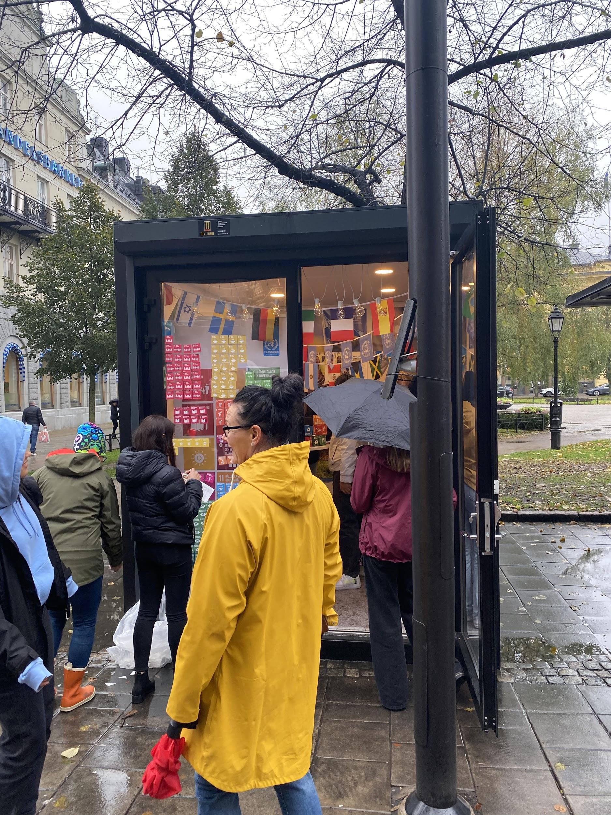
More
Pay attention to anniversaries (United Nations Day, Human Rights Day)
Raising money to charities
Telling citizens on the street about the Sustainable Development Goals

Slide 8
Thank you!

